Slide 1
Assessment of VESUVIO
Giovanni.romanelli@stfc.ac.uk

Slide 2
Background of the Instrument
We built up the spectrometer, starting from the simple empty tank in air, adding vacuum, adding the chimney, adding a turbo pump for the incident path (going to ~10 ubar to ~ 1 ubar) and finally adding the stick with no sample attached.
Start run | End run | Sample | Charge
17566 | 17589 | Empty tank in air | 24x90
17590 | 17620 | Empty tank in vacuum | 31x90
17622 | 17649 | Empty chimney in vacuum | 28x90
17651 | 17678 | Empty chimney in extra vacuum | 28x90
17791 | 17814 | Empty stick in extra vacuum | 23x90
There is a big difference in running the instrument in air against vacuum: Higher background of a factor of 2-4.
In the other situations, equal background within the statistics.

Slide 3
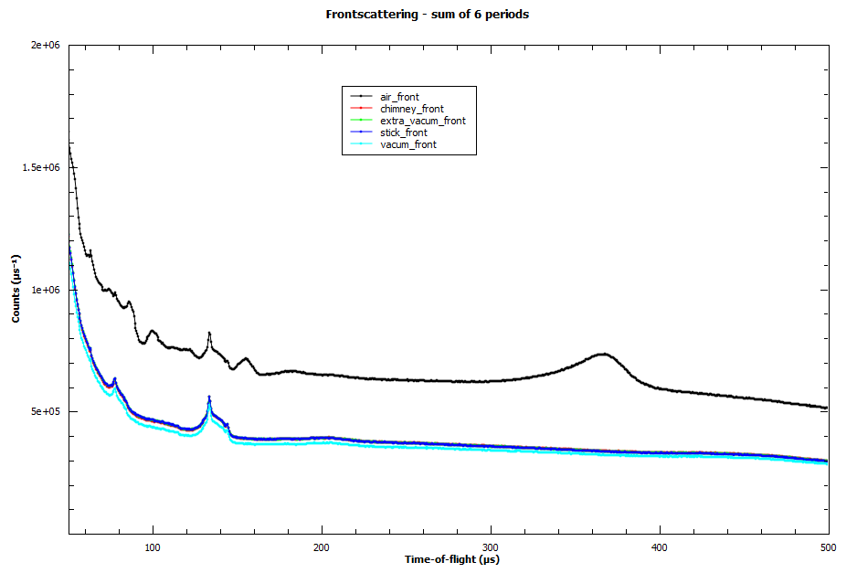

Slide 4
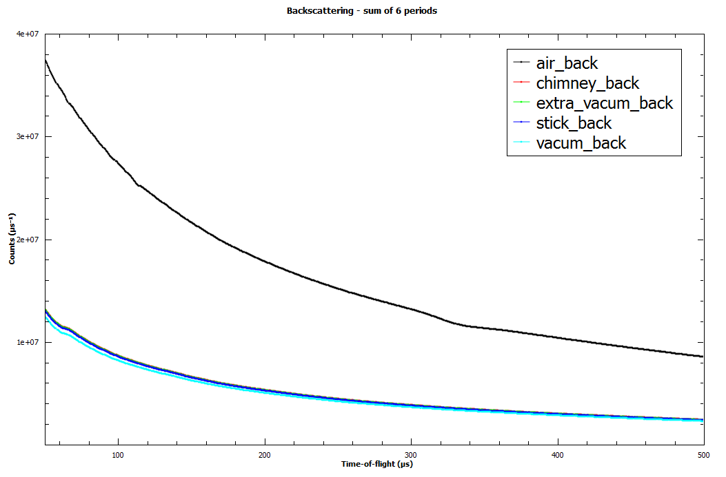

Slide 5
Position of the Bragg peaks for Lead
Start run | End run | Sample | When
17687 | 17712 | Lead 2 mm | March 2015
17083 | 17084 | Lead 2 mm by Seal | April 2014
15221 | 15223 | Lead 2 mm by M. Adams | April 2011
While the position of the Bragg peaks in backscattering seem to match those obtained in the past, there should be some issues for those in forward scattering. In this case, the displacement of the Cadmium foil in front of each detector (principally those facing downwards) could be responsible for a mismatch of the peaks.
I still have to check this!

Slide 6
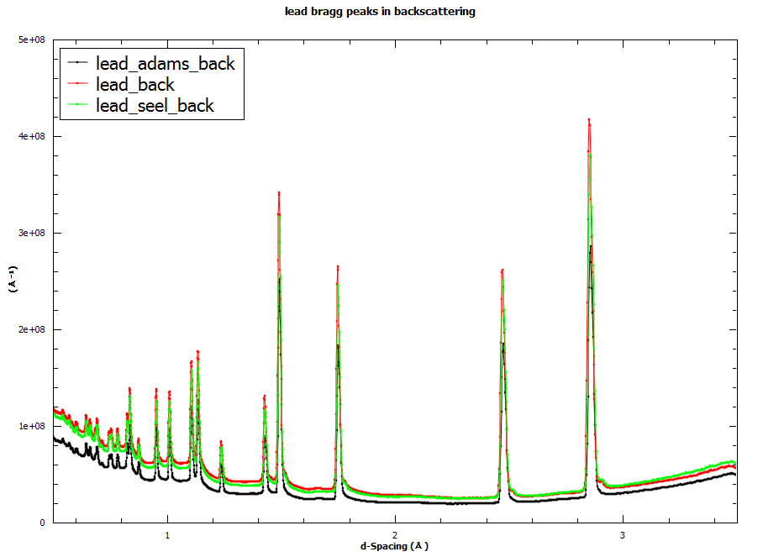

Slide 7
Effect of the displacement of a sample on the incident path
Start run | End run | Sample
17780 | 17784 | Centred Sn 0.5 mm
17815 | 17819 | Displaced 0.85 cm upstream
17820 | 17823 | Displaced 0.85 cm downstream
I see no appreciable difference for the position of the tin resonances. Any difference is hidden in the 0.5 us binning for the t.o.f. data.

Slide 8
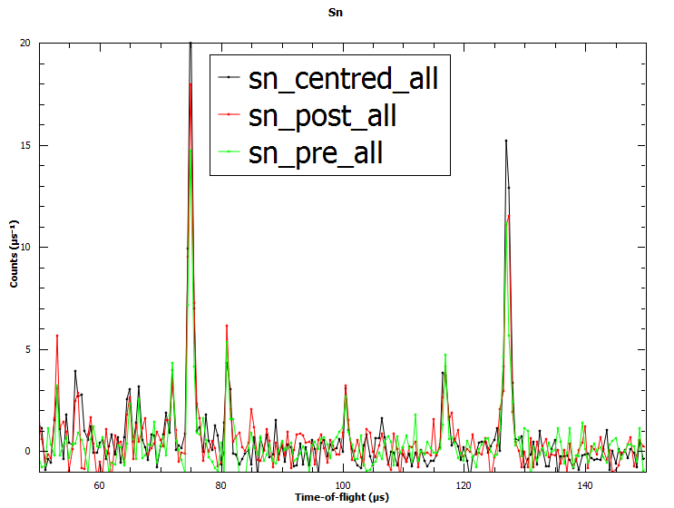

Slide 9
Effect of the displacement of a sample on the recoiling position
Start run | End run | Sample
17713 | 17779 | Centred PE 0.25 mm
17825 | 17848 | Displaced 0.85 cm upstream
17849 | 17862 | Displaced 0.85 cm downstream
The position of the recoil peak for H in PE is sensitive to a displacement of about 1 cm.
The two NCP for the PE sample upstream or downstream appear moved on the left or on the right against a well-centred sample.
I think that for a large sample, when the multiple scattering is corrected and the principle of superposition of effects can be invoked, a NCP could appear broadened due to the different responses from the first layers against the last layers composing it.
By the way, if this is applied to the elements composing air for a large volume around the sample position, it is possible to explain the broaden peak in the first figures of this document, for t~370 us.

Slide 10
